Slide 1
San Gabriel Valley
Regional Housing Trust
Working Group Meeting
Homeless Pilot Programs
October 13, 2021 11 AM

Slide 2
Budget Earmark Priorities- Overview
The SGVRHT received a budget earmark of $20 million to address the affordable housing shortage and homeless crisis in the San Gabriel Valley. In September, the Board approved funding categories as follows:
Project Pipeline Capital- $8 million
Revolving Loan Fund- $8 million
Homeless Pilot Programs- $4 million
$1.8 million committed, $2.2 million available

Slide 3
Homeless Pilot Programs- $4 million
Funds will support operations at participating tiny home sites (Baldwin Park and Montebello) and allow member cities to apply for capital funds to develop a tiny home site or pursue alternative homeless pilot programs
Pilot programs must produce homeless housing beds or units that are operational for a minimum of 2 years to receive the maximum funding amount of $25,000 per unit or a minimum of 1 year for prorated funding
This funding amount was selected based on the actual capital costs to develop a tiny home unit which can provide multiple years of homeless housing.
Eligible funding uses include: non-congregate bridge housing (tiny homes), new bridge housing or emergency shelter beds, adaptive reuse, site acquisition (e.g. master leasing), and other programs that produce homeless housing beds or units

Slide 4
Homeless Housing Pilot Examples
Adaptive reuse: convert a vacant or underutilized building or portion of a building to provide homeless housing beds/units; example: The Arroyo pictured, right
Site acquisition: purchase of a lot or building to develop homeless housing beds/units; master leasing of motel units
Emergency shelter: new emergency shelter beds operated for at least one year
Bridge housing: temporary housing with supportive services; example: Tiny Homes

Slide 5
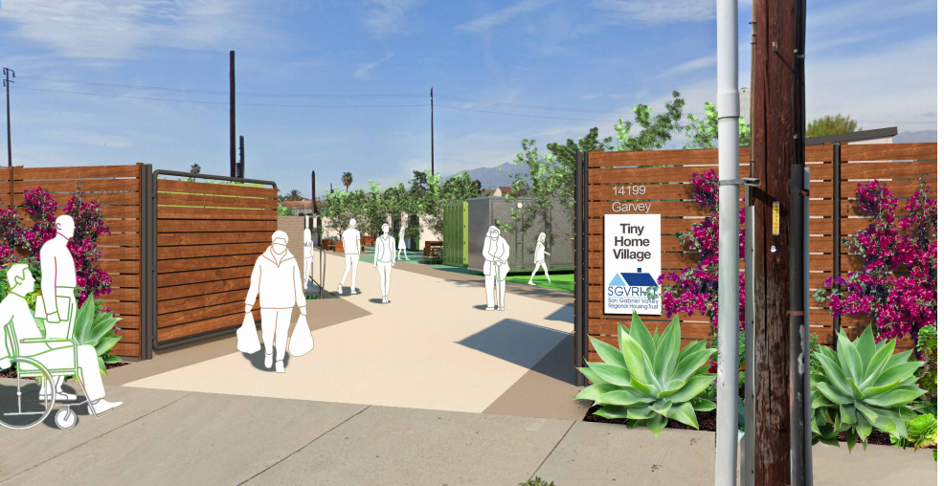
Tiny Home Pilot Program
Interim housing for persons experiencing homelessness with a local preference
On-site Case management and 24/7 security
SGVRHT will provide capital funding for: shelters, restroom facilities, office/case management space, and site prep.
Sites will be operational for 1-3 years
Program is highly responsive to State priorities for Homelessness and COVID-19 due to the non-congregate nature of the shelters.
Baldwin Park’s tiny home site, Esperanza Villa will be available for site tours beginning 11/20/21

Slide 6
Letter of Interest
Cities will submit an LOI and application to request funding consideration
The LOI is not a formal commitment, but will allow the SGVRHT and SRK to evaluate potential projects
Capital projects will require an initial feasibility review
SGVRHT staff is available to assist City staff during the application process

Slide 7
Application
Cities are encouraged to complete applications with as much detail as possible
Additional funding will likely be required to complete most pilot programs
City staff time will be required for successful pilot program implementation

Slide 8
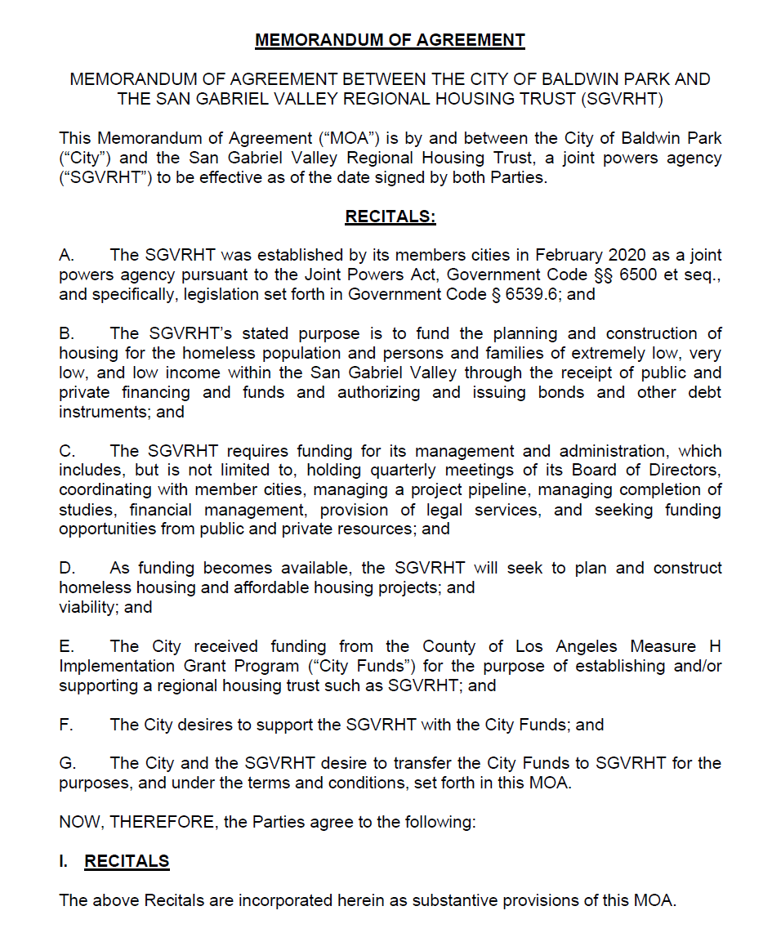
Memorandum of Agreement
Once projects are recommended for funding, the SGVRHT and the City will negotiate an MOA that will need to be approved by City Council and will represent a formal commitment to complete the project.
The MOA will detail the roles and responsibilities of the SGVRHT and member City.
SGVRHT staff is available to assist with City Council presentations

Slide 9
Project Evaluation
Projects will be evaluated based on readiness to proceed with a funding expenditure deadline of May 15, 2023
Applications will be accepted on a rolling basis with the initial review period in late October. Applications must be received by 10/26/21 at 5PM to be considered for this first round.
Initial funding awards are anticipated in December 2021
Projects with capital costs will undergo a feasibility analysis. A City may propose multiple sites and the most feasible site will be recommended for funding. For example if a City owns multiple lots that may be suitable as a tiny home site, SGVRHT’s consultant team, SRK Architects, can evaluate the access to utilities at the site and recommend the most appropriate site.

Slide 10
Upcoming Opportunity- Revolving Loan Fund $8 million
This month, the SGVRHT will release a request for proposal to a consultant to develop a Revolving Loan Fund (RLF)
The RLF will provide access to early acquisition and predevelopment capital
The RLF will allow the State Earmark funds to be recycled to support projects on an ongoing basis as loans are repaid and loaned to new projects
The selected consultant will set up working group meetings with member cities, developers, and additional stakeholders to ensure the funding guidelines are responsive to member city needs
Projects may receive low interest rate loans of up to $40,000 per unit of affordable housing; additional guidelines will be developed by the selected consultant and SGVRHT

Slide 11
Questions?

