Slide 1
Tiny Homes: bridging the gap from shelter to permanent housing
Marisa Creter, Executive Director
Yuriko Ruizesparza, Community Services Supervisor
Brielle Acevedo, Housing Trust Manager
Notes:
Marisa to briefly introduce everyone

Slide 2
Regional Partnerships & Collaboration
Notes:
Brielle to provide quick overview. Describe Council of Governments,. COG overview- 31 cities including Baldwin Park, Baldwin Park City size, COG and cities formed the Trust

Slide 3
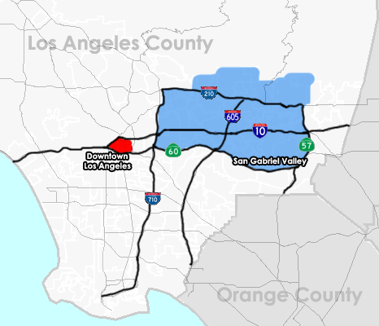
San Gabriel Valley
31 cities in Los Angeles County, east of Downtown Los Angeles
Notes:
Marisa

Slide 4
Baldwin Park demographics & motivation
City size of 72,000- medium size City in California, larger City in the San Gabriel Valley
The City employees about 300 staff
Baldwin Park point-in-time homeless count: 275 in 2022, 556 in 2020, 263 in 2019
Baldwin Park has become a leader in addressing unsheltered homelessness
The City tackled the lack of shelter in the San Gabriel Valley by developing 25 units of individual bridge housing and 50 beds of family bridge housing
Notes:
Yuriko

Slide 5
City and COG programs
Workforce Development
Food Recovery
Landlord outreach and incentives
Recreation Programming
Crisis Intervention
Prevention and Diversion
Notes:
Marisa- expanding beyond shelter to address all aspects of homelessness and intergrating innovation and sustainability

Slide 6
Bridge Housing Overview
Notes:
Brielle to provide program overview

Slide 7
Notes:
Brielle- Why the noncongregate model? Cost, ability to implement quickly, scale

Slide 8
Funding
Development and Operational Costs
Notes:
Marisa

Slide 9
Capital funding
Funding sources included State Budget Earmark funding allocated to the SGVRHT and SGVCOG and local funding, Measure H, allocated to the SGVCOG and City of Baldwin Park.
The SGVCOG and SGVRHT provided Project Management to assist City staff in capacity building to oversee the project and manage procurement
Development cost is $25,000 per unit including site development.
Restroom trailers
Case management office
Connection to utilities
Asphalt paint
Notes:
Marisa, collaborative funding across, State, County, COG, City

Slide 10
Operational funding
24/7 staffing and services
Meals and direct client assistance
$87/bed/night
Bed rate
The SGVRHT funded the first year of operations. The County of Los Angeles has awarded a funding grant for year 2, extending the program through November 2023.
Notes:
Yuriko- what goes into a bed rate and why is this model so important; COG/city funds inspired County funds

Slide 11
Design and Building
Site elements, building codes, and utility connections

Slide 12
Non-congregate shelter: tiny home details
64+ square feet
Insulated + AC/heat
Locking door
Overhead light
Bed, desk, shelving/storage
ADA complaint
Mold/mildew resistant
Notes:
Brielle- Why tiny homes, features

Slide 13
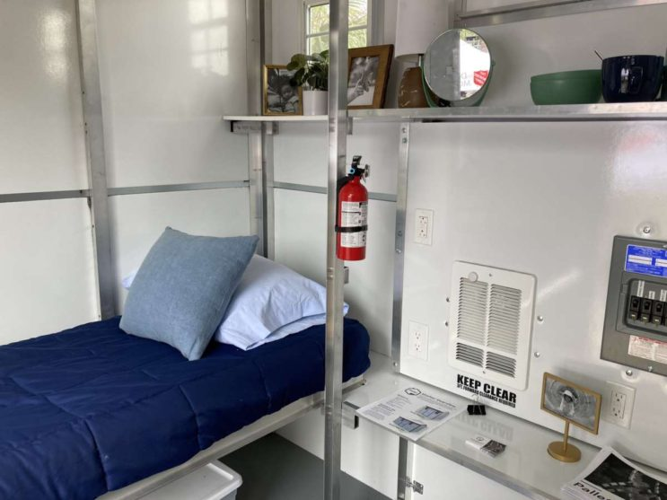
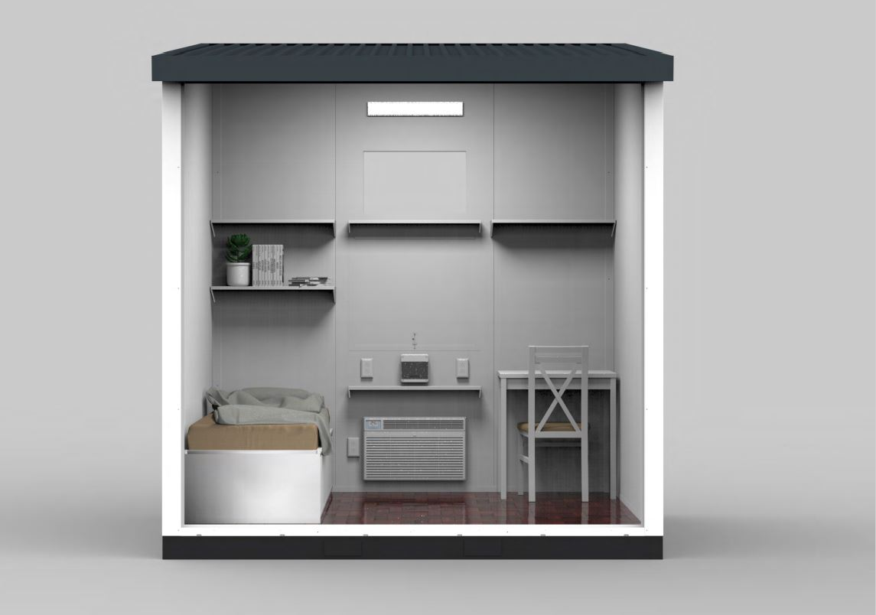
Notes:
Brielle

Slide 14
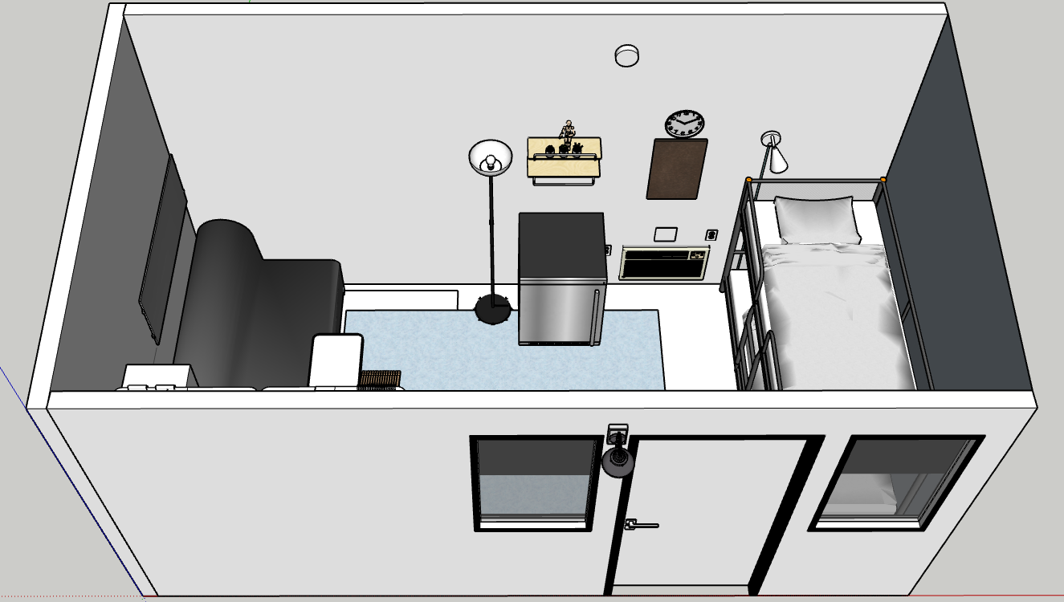
Notes:
Brielle

Slide 15
Emergency Shelter Resolution
Provides the ability to deploy sites quickly
Notes:
Yuriko

Slide 16
Staffing & Operations
Services provided onsite

Slide 17
24/7 staffing and supportive services
Resident aides and safety monitors
Case managers
Housing navigators
Volunteers
Notes:
Marisa- tie in onsite staffing with larger system

Slide 18
Success Stories
Connections to permanent housing and tiny homes from the client perspective

Slide 19
Transitions to permanent housing
The first Esperanza Villa resident placed in permanent housing was a 76-year-old woman who had been homeless on and off since 2014. After staying at the tiny homes site for about 3 months, she is no longer homeless.
The second client connected to permanent housing was also a senior woman. She spent 4 months at Esperanza Villa before receiving a County Housing Choice Voucher.
4 additional clients have transitioned to permanent housing and all residents are working toward their housing plan
Notes:
Yuriko

Slide 20
Emotional Impact and Additional Services
Safety and ability to sleep through the night
Access to consistent hygiene and nutrition services
Basic needs are met to enable ability to focus on life goals
Connections to additional services
Clients living at Esperanza Villa also celebrated holidays and milestones including:
Thanksgiving Lunch
Christmas Gift Cards (Senator Rubio)
Christmas Luncheon & Dinner
Valentine’s Day Gift Boxes
Easter Egg Hunt
Birthday Celebrations

Slide 21
Notes:
Brielle

Slide 22
Community Engagement
Before and after site opening

Slide 23
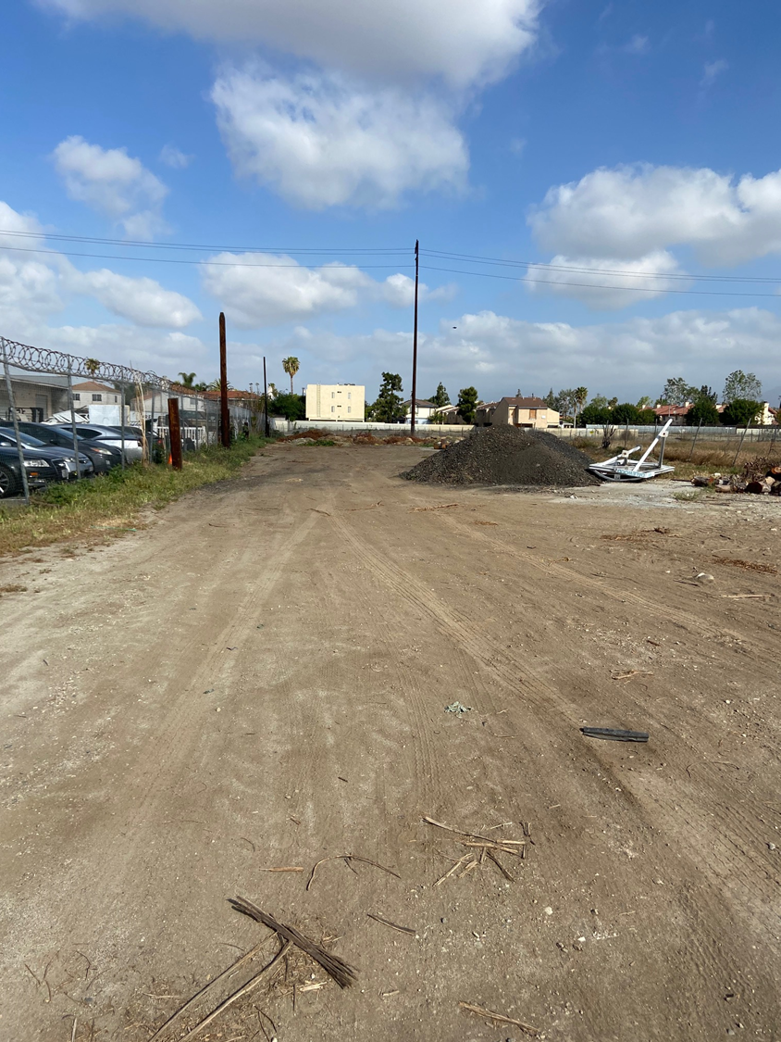
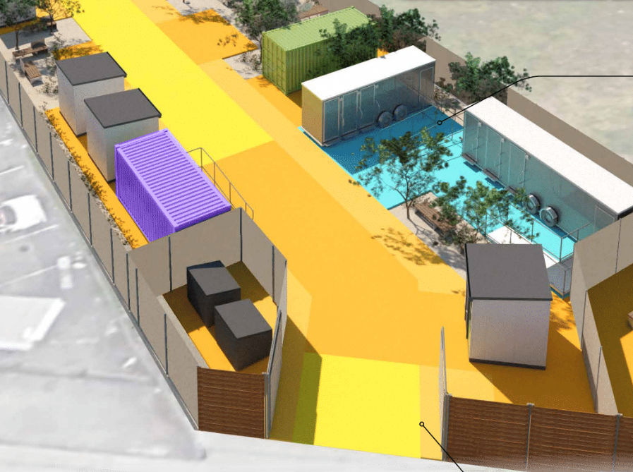
Community engagement, site tours, and FAQs
Notes:
Yuriko- Stakeholders, process

Slide 24
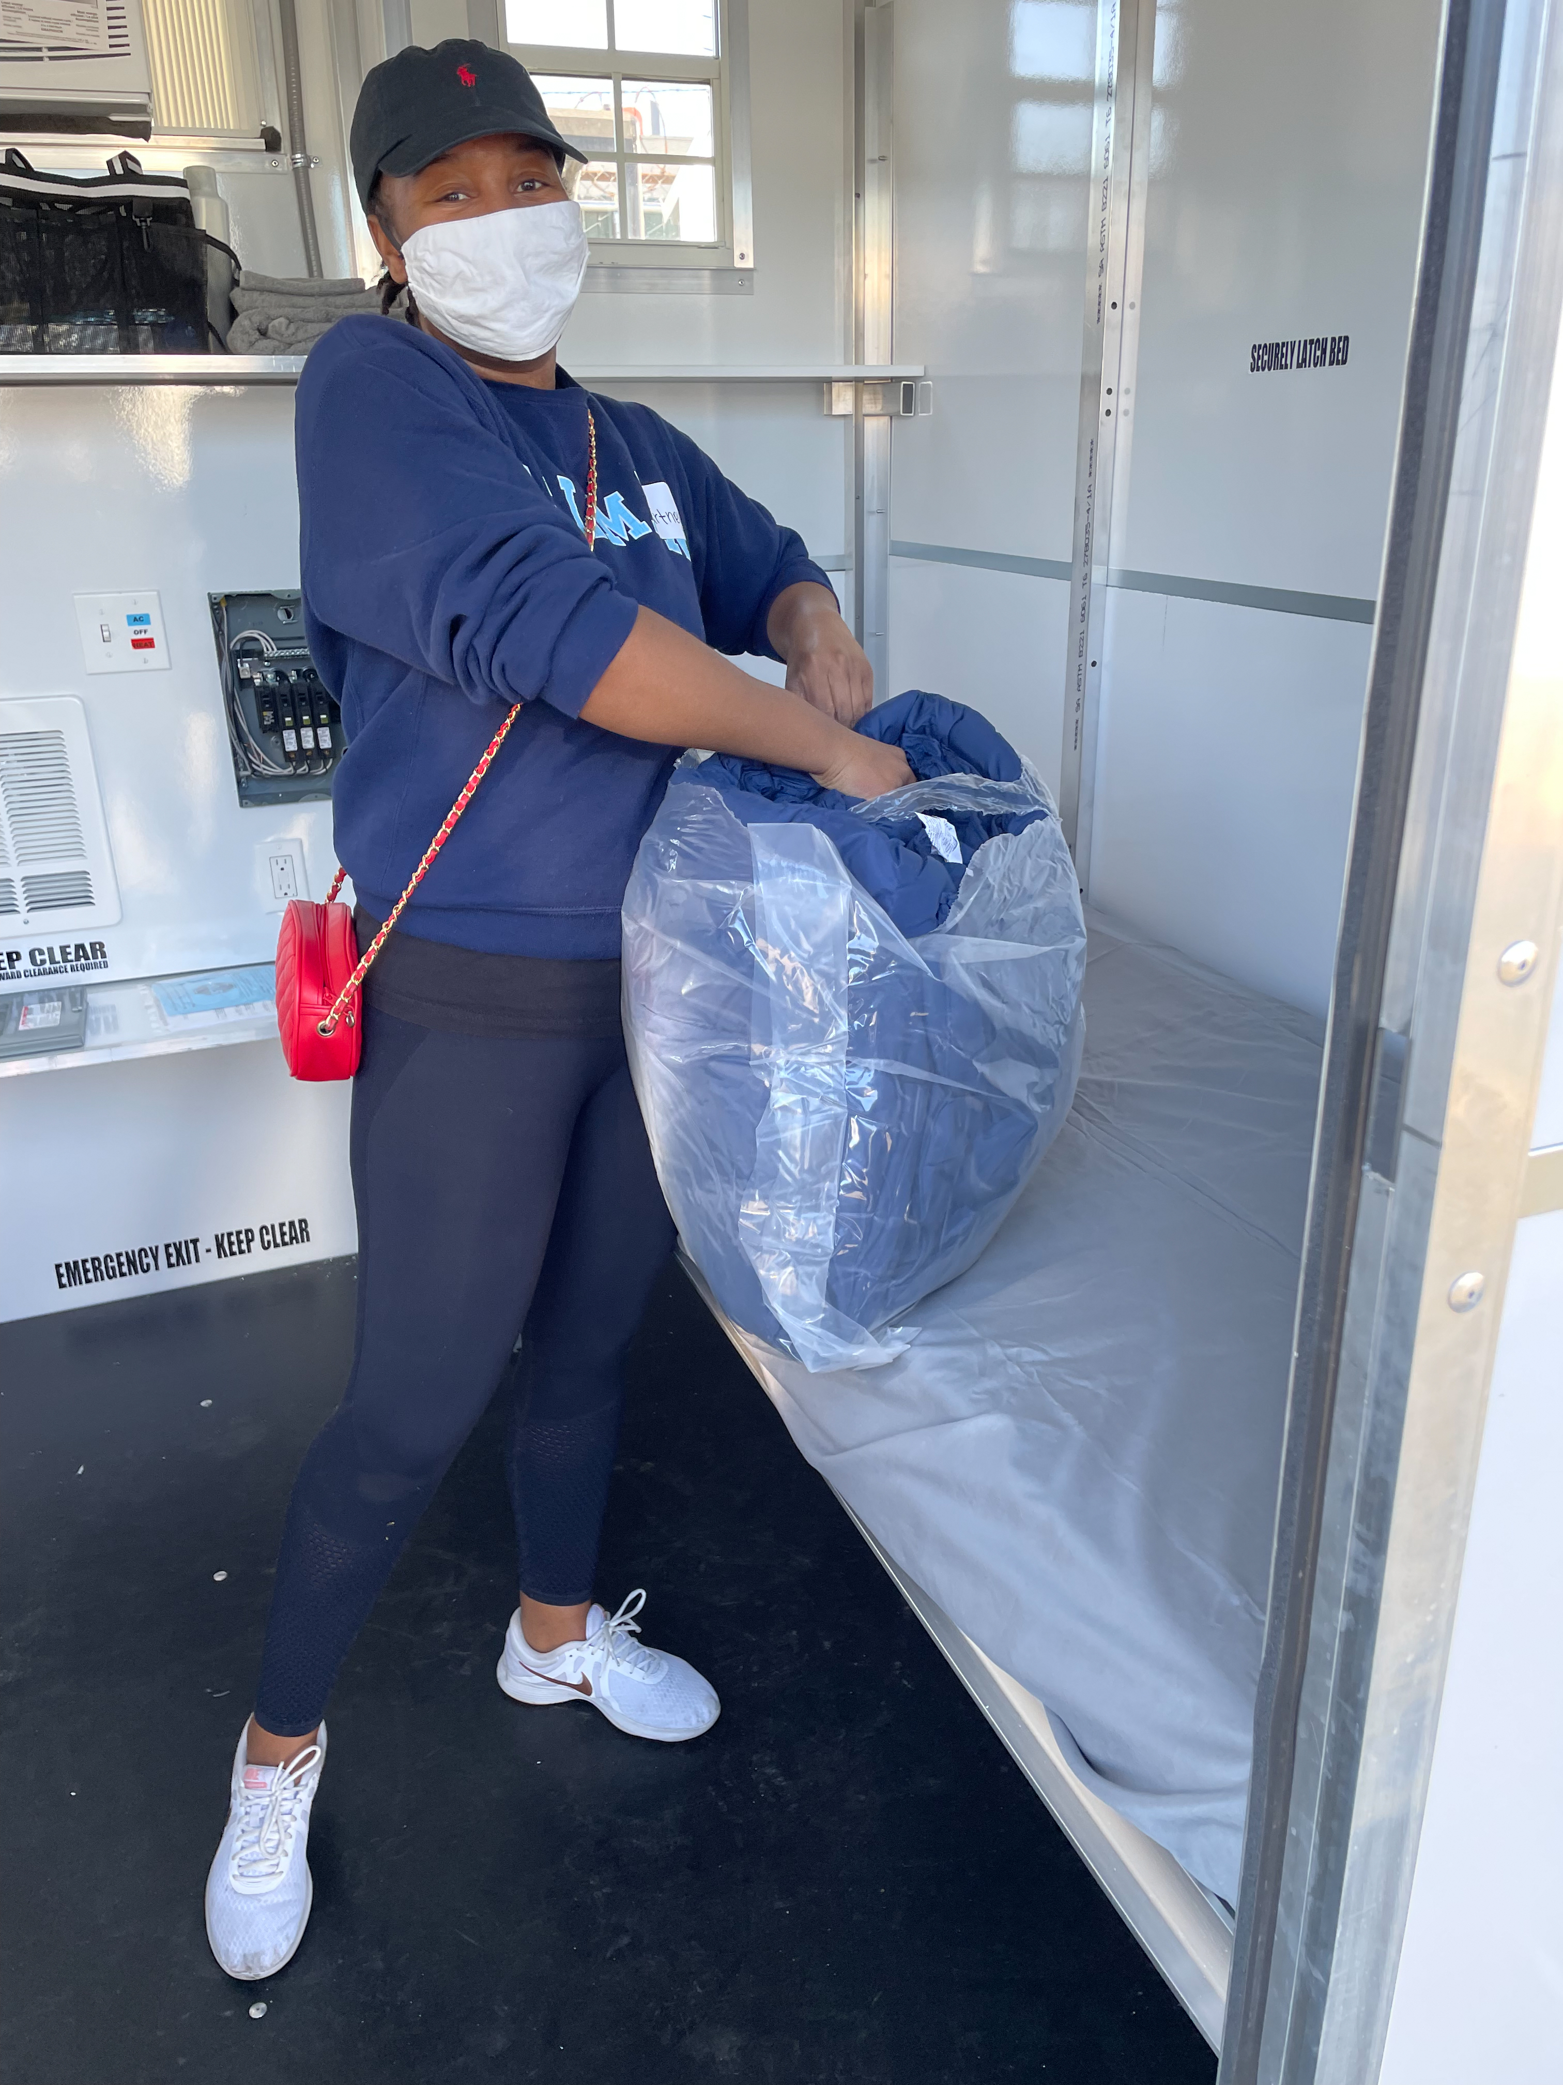
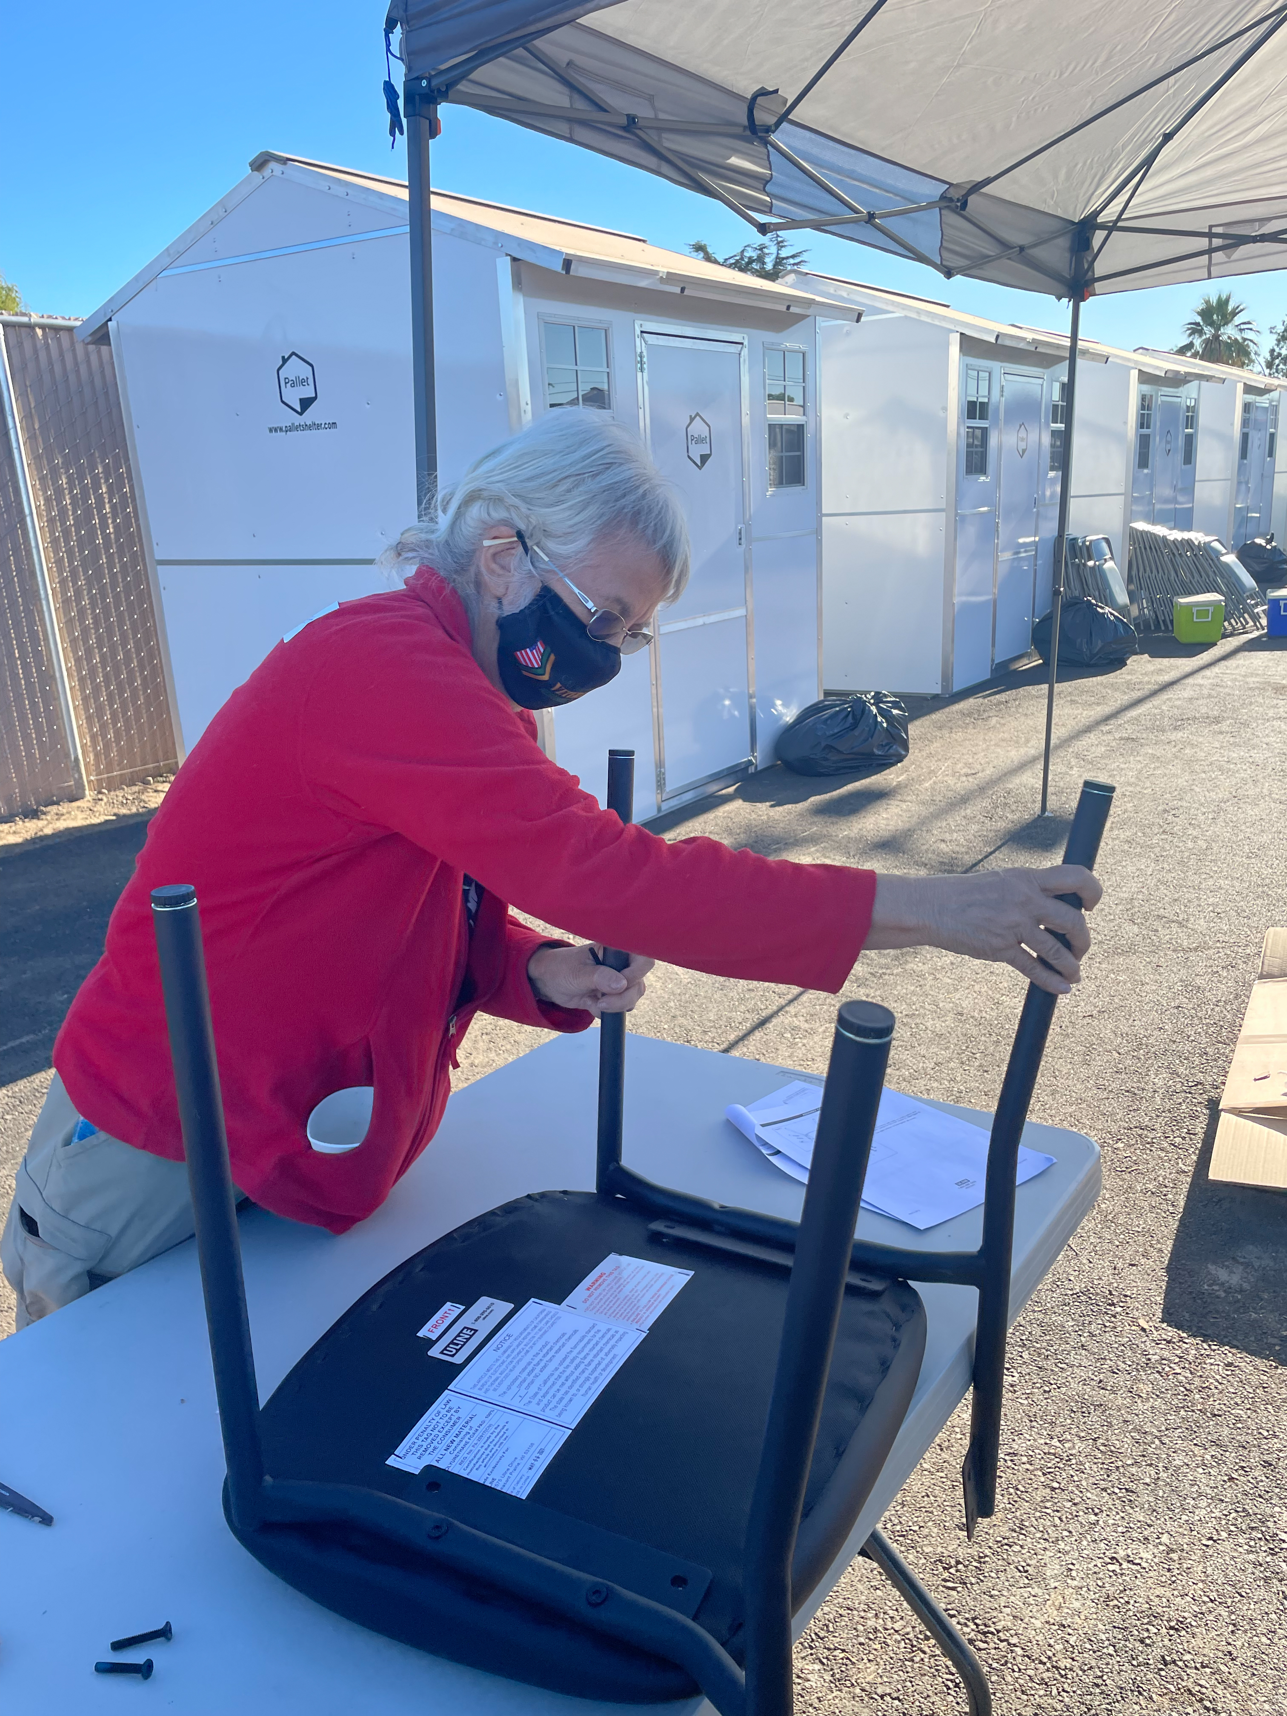
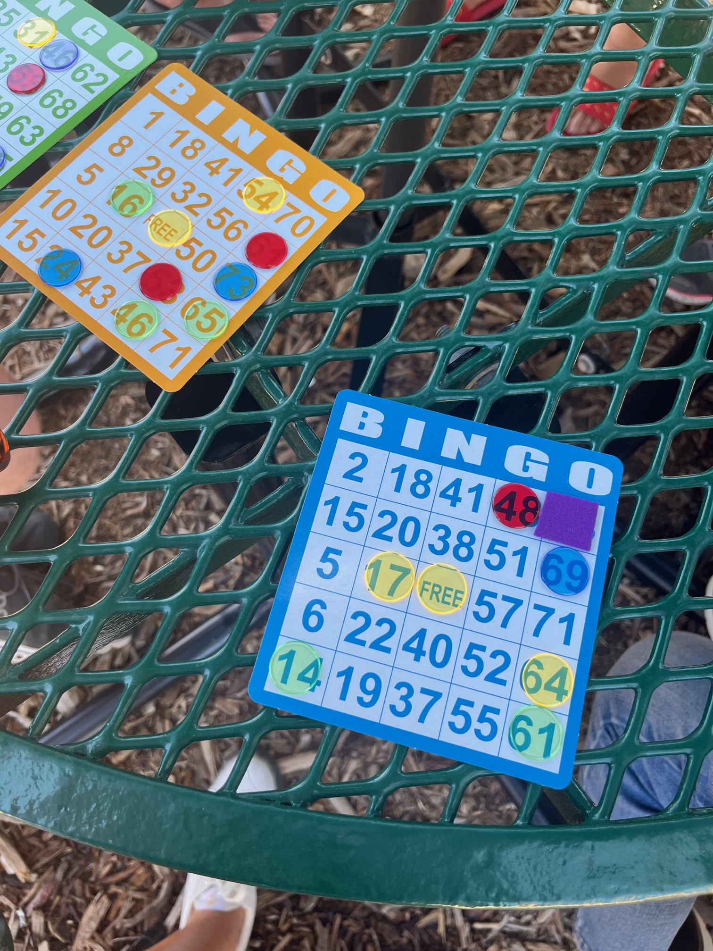
Volunteer Opportunities
Notes:
Marisa- Village 143: Tangibly improve the lives of families living at Serenity Homes through acts of kindness
Gain greater empathy for families experiencing homelessness and use that empathy as inspiration to help our community
Challenge stigmas that friends, family, and members of our community might have about people experiencing homelessness

Slide 25
Leveraging Community Partnerships
Habitat for Humanity: volunteer construction team and volunteers
Ikea: furniture donation
Kaiser: grants to support senior services and connections to housing
Public schools, church groups, community groups: hygiene kits, service days, fundraising
Notes:
Yuriko

Slide 26
Scalability
Technical assistance, knowledge sharing, and upcoming projects

Slide 27
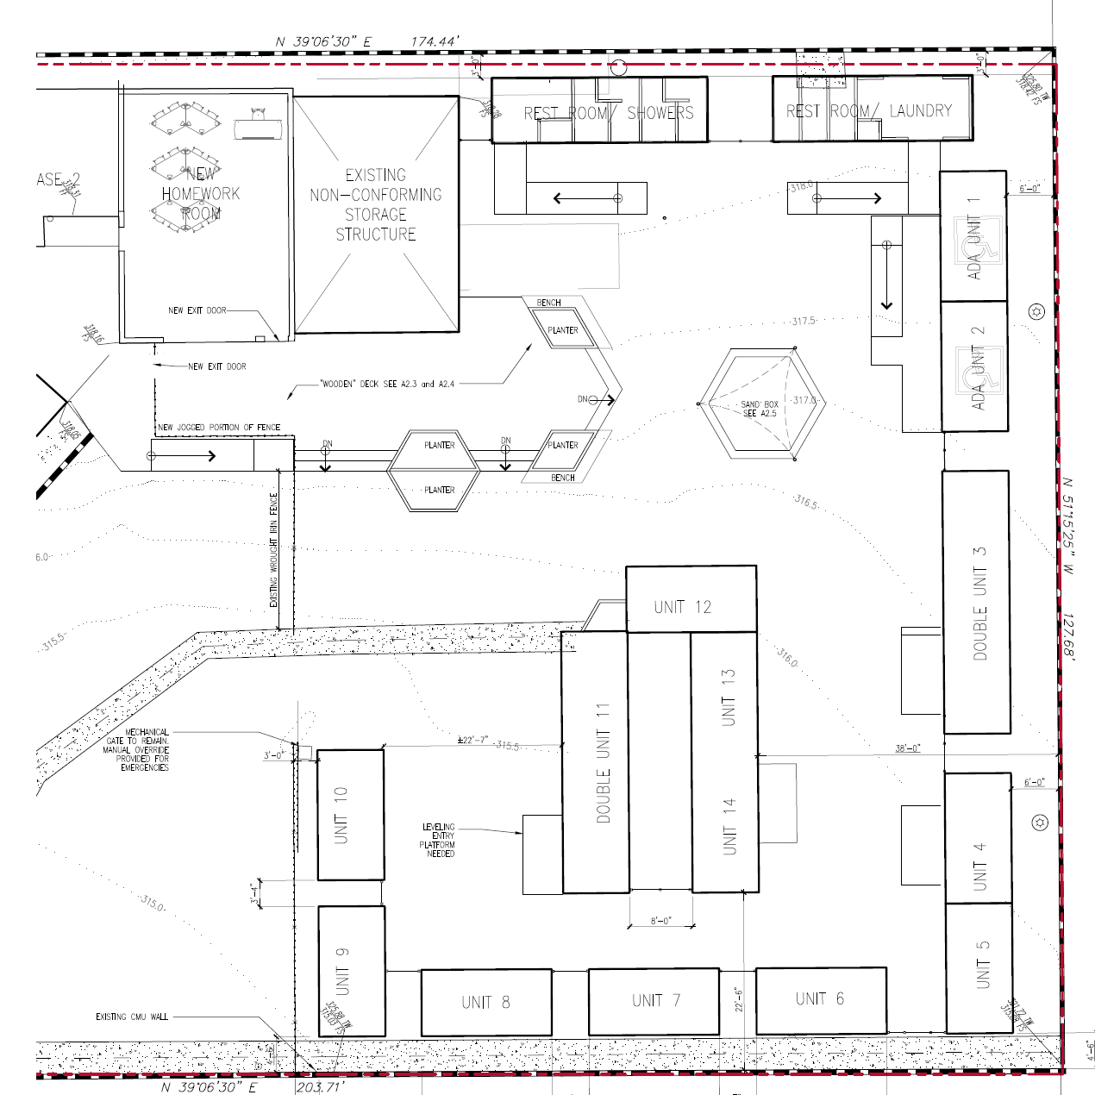
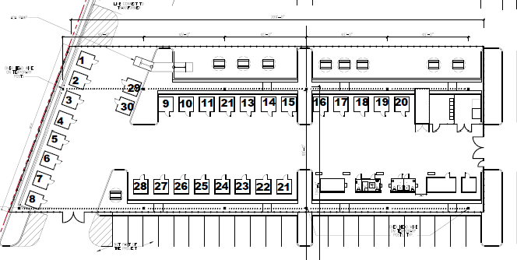
Site selection and plan development
Notes:
Marisa- Add, Montebello sq ft?, Serenity 28,000; adding facilities at grade

Slide 28
Site tours & resource sharing with other cities and providers
Burbank
Malibu
Torrance
Hawthorne
Fontana
Paramount
Los Angeles Homeless Services Authority (LAHSA)
Montebello
Notes:
Brielle- RHT how to

Slide 29
Operation Stay Safe
30 units of tiny home bridge housing in the City of Montebello
Notes:
Brielle

Slide 30
Lessons learned
Planning for lead times especially with supply chain issues
Coordination with utility companies to create/upgrade connections
Navigating City council and building approval process
Establishing robust Community Engagement and transparency
Public Safety linkages
Master Scheduling
Multidisciplinary team including staff and decision makers
Political support/champion
Notes:
Yuriko

Slide 31
City Manager role/next steps
Serve as project champion
Encourage coordination across departments
Liaison for other cities to develop interim housing
Notes:
Yuriko

Slide 32
Coming soon!
Baldwin Park Family tiny home site opens September 24th!
Notes:
Yuriko

Slide 33
Contact us
mcreter@sgvcog.org
bacevedo@sgvrht.org
YRuizesparza@baldwinpark.com
sgvrht.org/tinyhomes
Notes:
Marisa- closing, where to find more info, transition to Q&A

